Slide 1
Interest Rates

Slide 2
What is interest Rate?
https://www.youtube.com/watch?v=GHHesANT6OM

Slide 3
Simple interest is determined by multiplying the daily interest rate by the principal by the number of days that elapse between payments.
Simple Interest = P × I × N
where:
P=principle
I=daily interest rate
N=number of days between payments

Slide 4
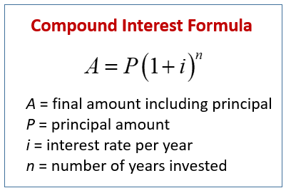
Compound interest (or compounding interest) is interest calculated on the initial principal, which also includes all of the accumulated interest of previous periods of a deposit or loan.

Slide 5
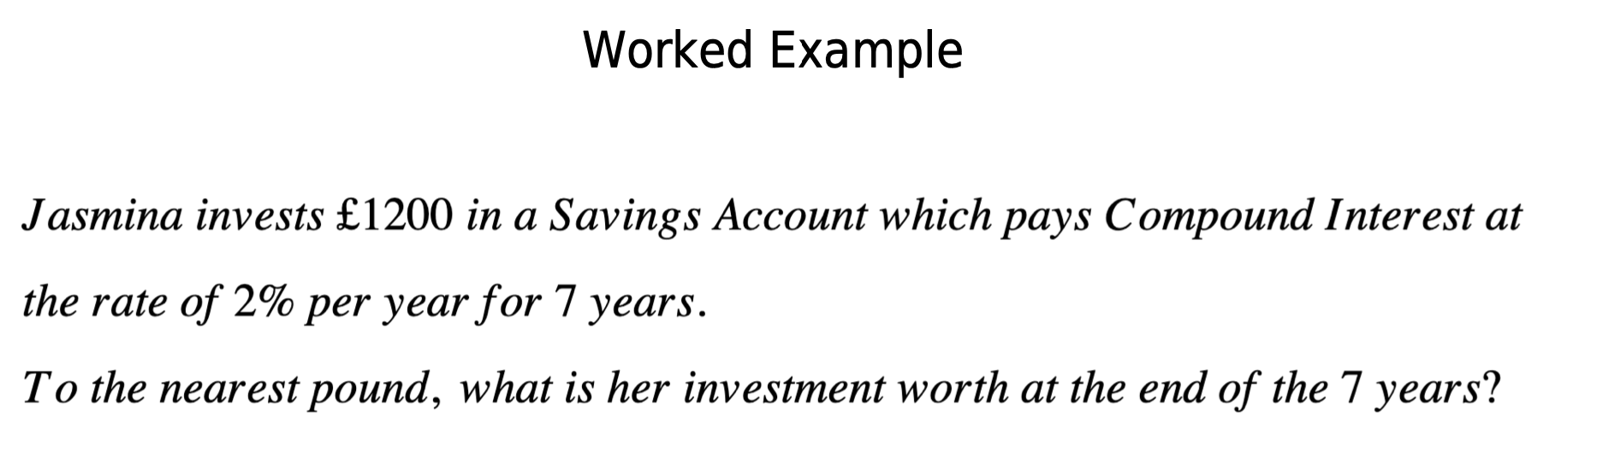
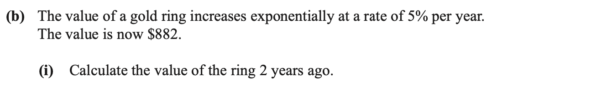

Slide 6
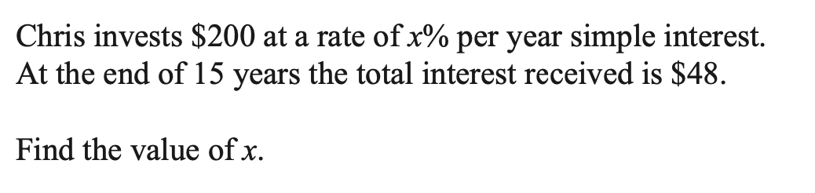
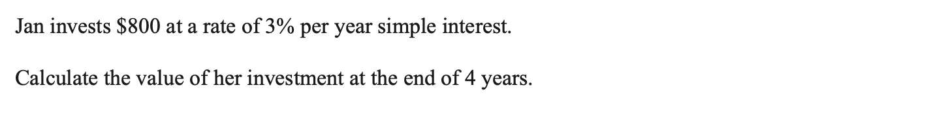

Slide 7
Simple Interest Questions
Question 3: John loans $2,000 to a friend at a simple interest rate of 5% per year. If the loan is to be repaid in 3 years, what will be the total amount repaid at the end of the loan period?
Question 4: Sarah deposits $1,500 in a simple interest bearing account at a rate of 2.5% per year. After 4 years, how much interest has Sarah earned on her initial deposit?

Slide 8
Compound Interest Questions
Question 1: Emily invests $3,000 in a savings account which pays compound interest at the rate of 3% per year. If she leaves the money in the account for 5 years without making any additional deposits or withdrawals, how much will her investment be worth at the end of the 5 years?
Question 2: Mark puts $5,000 into a retirement account that earns 4% annual compound interest. Assuming he makes no further contributions or withdrawals, what will the balance of his account be after 10 years?

Slide 9
What is incentive?
https://www.youtube.com/watch?v=lk1_dTO58hQ

Slide 10
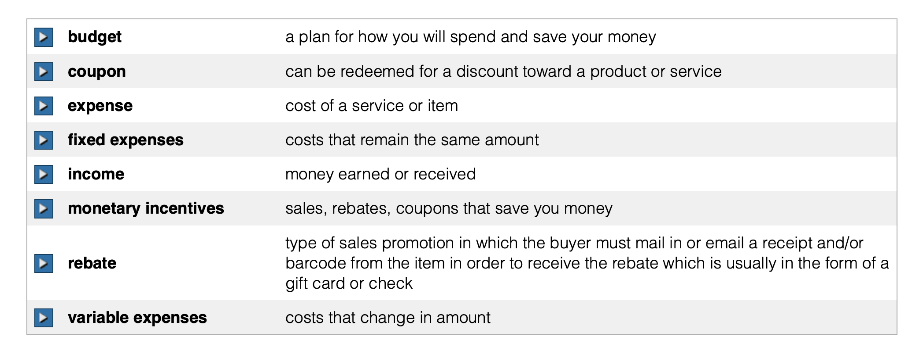

Slide 11
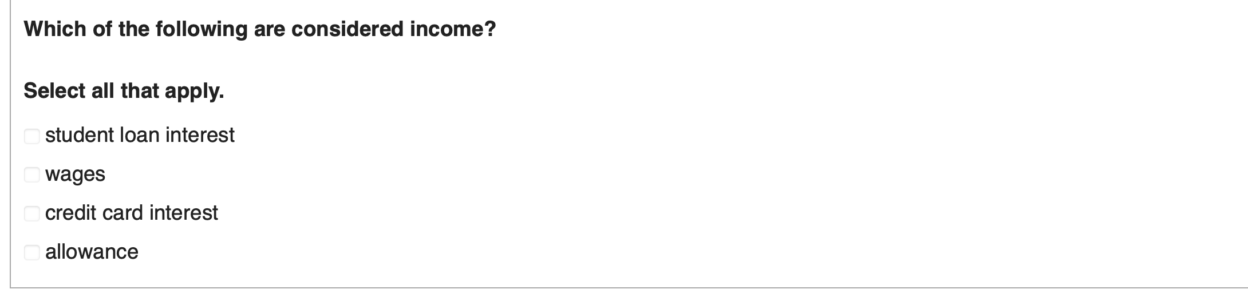


Slide 12
